Slide 1
UNSW Computational Intelligent Systems for State & Community Resilience: Haus Mama
A Focus on Women’s Networks, Digital Technology & AI-Enhanced Capabilities.
Emma/Hervi/Stephanie Copus-Campbell
UNSW Leadership Group
June, 2024
UNSW Canberra

Slide 2
Outline
UNSW – Who we are, what we represent
Intelligent Systems for State & Community Resilience Hub (Capability Systems Centre)
Our technology
Our mission, impact pathways and co-design approach
Our current initiatives
The ‘Haus Mama’ Initiative

Slide 3
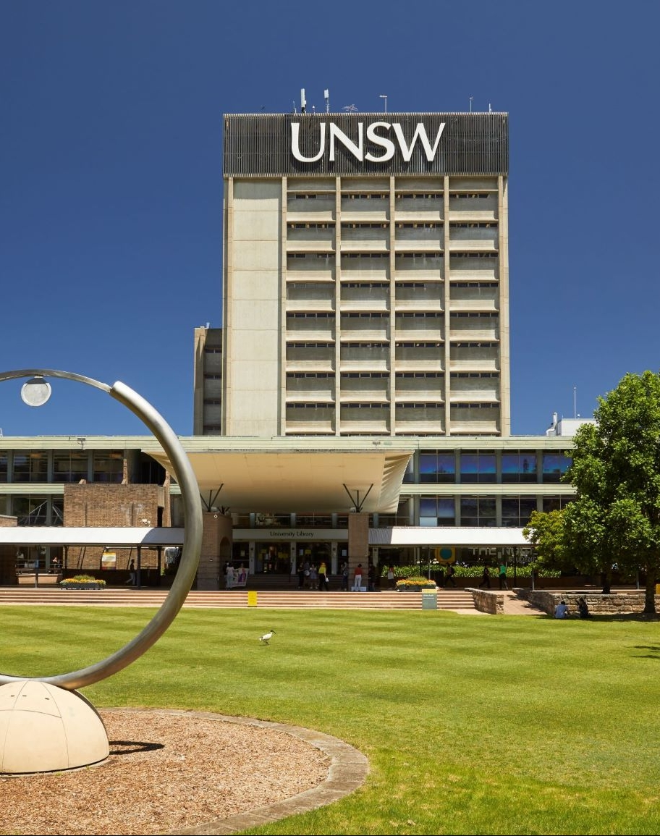
UNSW – The Organisation
World-class academic institution
Track record of global impact
Values & Strategic Focus
Mass & Expertise
Institutional Partnering

Slide 4
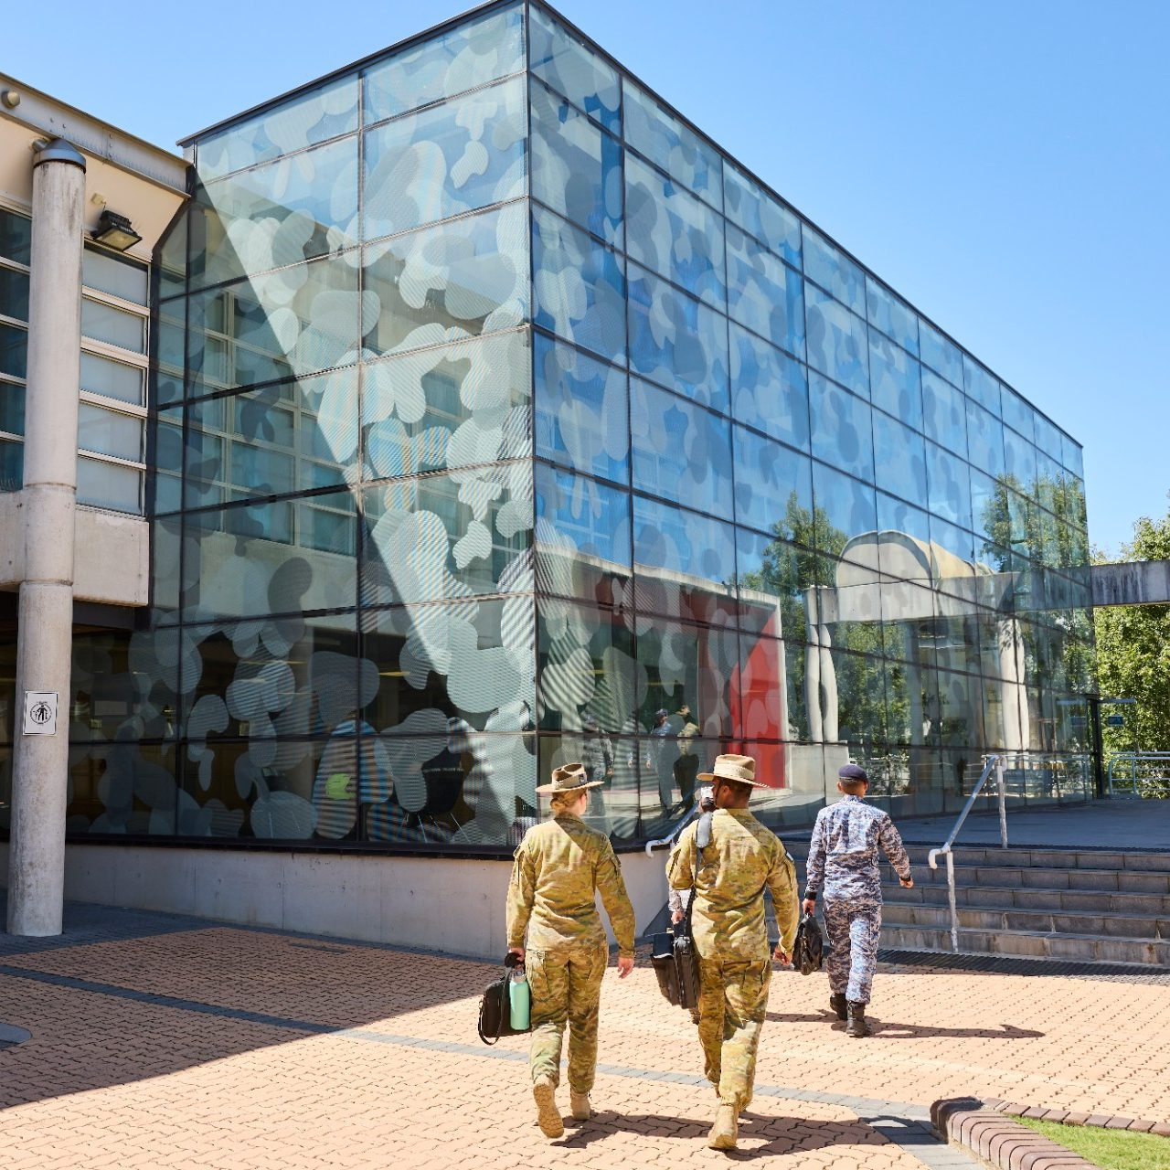
UNSW Canberra - Capability Systems Centre
Enabling and accelerating industry and societal digital transformation by creating next generation systems engineering practices and models
Harnessing advances in decision science, and incorporating technological innovations into an integrated collaborative problem‑solving approaches
Creating and delivering education and learning requirements to build digital engineering
Integrated digital approach - model-based systems engineering
Proactively engaging with complexity and systems thinking
Evidence based decision making
Data and decision analytics
Critical thinking
Leading research, education, and delivery excellence in Digital Engineering

Slide 5
A ‘Hub’: Computational Intelligent Systems for State & Community Resilience
Our Vision:
Co-create networked intelligent systems to strengthen resilience in communities (State).
Our Focus:
Vulnerable & High Risk States (Fragile States).
Our Strategy:
Building resilience through investing in local leadership coalitions, networks and collective action to strengthen local institutions, economic welfare and social cohesion.

Slide 6
Our ‘Network-Centric’ Approach
World class interdisciplinary team
Computational intelligent systems, Academic + Research, Policy + Strategy
Combining and encouraging multidisciplinary ideas, knowledge and a diverse range of skills and capabilities; and
Genuine international and local partnerships, collaboration and co-creation
Tech Companies, Universities, Global Experts, Local Development Actors (civil society)
Proactively engaging with complexity and multi-dimensional nature of the challenge;
Co-creating innovative intelligent systems
Support locally led leadership coalitions and networks (an emphasis on network-centric operations);
Utilising leading-edge technologies from computational capabilities
Pro-actively engaging and influencing international and local policies and strategies.
Excellence
Partnerships
Global Impact

Slide 7
Our Motivations
Addressing poverty, insecurity, inequality, human rights
especially concerning women and children
Proactively responding to the complex and contested global and regional drivers
Working with partners and networks
The formidable challenge of better assessing, predicting, preparing and responding to fragile states
Tackling corruption, particularly the risk of ‘strategic corruption’;
Concerns about the rise of digital authoritarianism and threats to democracy;
How to support the critical issues of economic welfare, social cohesion and the general resilience of communities and citizens;
Privileging the local: defending local cultures and values, empowering local leadership and networks (local agency), and supporting local resilience through more direct engagement and resources.
Poverty
Insecurity
Global Impact

Slide 8
The Regional Context
Highly complex, contested and disrupted regional, national and local security – development contexts
Exposing already highly vulnerable and high risk states/communities
Multiple actors and opaque relationships
Contested values, plurality of goals and perspectives
Insidious nature of systemic corruption and foreign malign influence
PNG is initially our highest priority

Slide 9
Digital Technology
Centrality of Information Technology today
Disruptor
Fast developing and powerful capabilities
AI, Data Analytics, Machine Learning
Threats & Opportunities
(Can) Democratise access to capabilities/information
New/innovative partnerships
Support/Empower local change agents
Agency over structure (collective action)
Offers Security (cyber) Capabilities
Complexity/Volume of Information

Slide 10
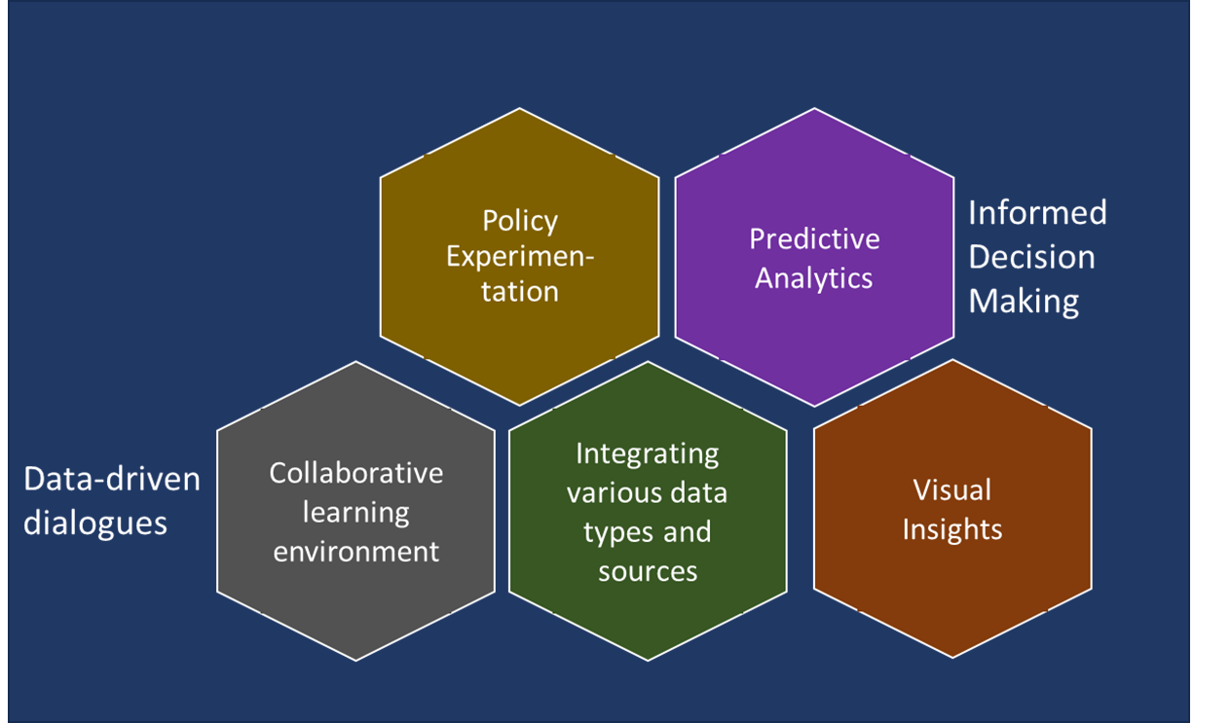
Digital Technology

Slide 11
Impact Pathways
Empowerment (localization)
Locally-led and collaborative problem-solving approaches
Focus on approaches for building ownership, agency and sustainable changes
Decision Support
Digital technology solutions to enable access to relevant information for informed and equitable decision making
Focus on information needs in environments characterized with weak state, corruptipon, complexity, uncertainty, and fast-paced change
Partnership
Establishing genuine partnerships
Focus on key stakeholders (change agents) and pathways for collective action
Notes:
Establish a world class team of experts (UNSW, local stakeholders, & others)
Focus on the unique range of vulnerable and high risk (fragile) countries (states).
Contribute expertise
Ideas, high quality knowledge and unique range of skills and capabilities;
Identify and build long term relationships, dialogues and partnerships; and
Co-create innovative digital modalities and capabilities to empower and facilitate legitimate locally led leadership and change (governance).

Slide 12
Needs and objectives
- stakeholder’s vision
Requirements Analysis
- Constraints (technical, data,..etc)
- Sustainability considerations
Prototype solution
- User feedback
Design and development
Deployment
- Training
-Supporting services
Planning
- Team assembly
- Partnership formation
Co-design
Approach
Integrity
Collaboration
Agility
Trust

Slide 13
Initial Priorities & Efforts
Country Vulnerability & Risk Assessment
National Risk Assessment (PNG AML/TF and corruption, Pacific)
Women’s leadership, security and economic empowerment
Haus Mama (PNG)
Security, Peace-building, Law & Justice
PNG Economic & Public Expenditure Mgmt
Natural Resource Management
Agriculture & Youth
Agric & Schools Garden Initiative (Morobe PNG)
Provincial & District Performance Information System

Slide 14


Slide 15


Slide 16
The focus is on the network (not strengthening an individual organisation or institution)
The objective is to provide the key functions that the network require to enhance agency and contribute as efficiently as possible to resilience (acknowledging the current international aid system is not working)
Priority functions could be virtually anything however initial consultations include:
Resources (pooled funds, grants mgmt. system)
Communication (Various, multilevels)
Knowledge, data
Legal support
International partners
Cyber security
Key Points:
PNG Women Network Platform

Slide 17
Diverse and inclusive – shared foundational beliefs, values, and ethics
Motivated to work with others (collective action)
Track record of good governance, transparency and accountability.
Priority focus on their communities.
Efforts in priority areas – leadership, security, peace-building, health, education, business
Strong bonds and relationships of trust
Intimate understanding of the sensitivities, contextual issues, and problems faced by their communities
APNGWLN
Strengths

Slide 18
Marginalized and disenfranchised in their own development space
Maintaining and enhancing their network
Numerous business impediments
Ownership of their own data, analysis and reports
Access to relevant information, resources and partnerships
Challenges

Slide 19








Haus Mama Platform
Underpin and support APNGWLN and partners (Women in Coffee) key functions and activities
Fit for purpose platform co-designed to empower APNGWLN and enable their vision to engage and support PNG grassroots civil society
Members ‘Mgmt Space’ and own database-Activities
Pooled Funds from Partners Disperse funds to Members & Affiliates
Grant Management System Disperse funds to Members & Affiliates
Network Communication system Multiple levels/options
Access
of legal and domestic violence resources
Secure management of communications and information
(protect from disinformation)
Access to
Training & Business Opportunities
Asynchronous/offline, low-bandwidth

Slide 20
Haus Mama
Login Screen

Slide 21
Haus Mama
Major Options Screen

Slide 22
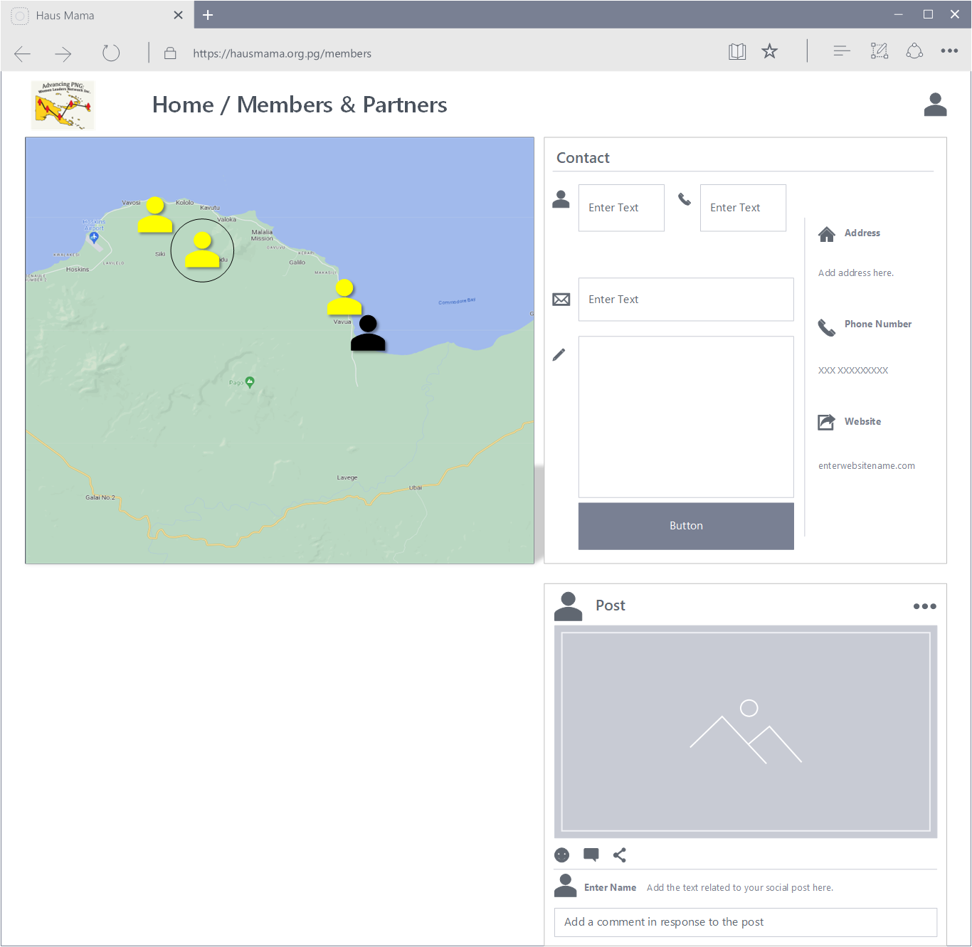
Haus Mama
Membership Screen

Slide 23
Questions/Discussion

